Slide 1

PROJECT ON
Vehicle Dataset Analysis
Presented by:
Vamshi Krishna Mummadi
Gouti Sagar

Slide 2
Agenda
Dataset Overview
Loading the Dataset
Dataset Structure
Summary Stats
Finding Missing Values
Understanding the Dataset
Handling Missing Values
Duplicates & Inconsistencies
Data Type Corrections
Bivariate Insights
Visualizations
Conclusion

Slide 3
Dataset Overview
The dataset contains detailed information about used vehicles, including pricing, specifications, and categorical attributes.
It includes a mix of numerical columns (year, price, mileage, cylinders, doors) and categorical columns (make, model, fuel type, transmission, body type, drivetrain, colors).
The dataset is used to understand vehicle characteristics, identify data quality issues, and prepare the data for further cleaning, analysis, and modeling.

Slide 4
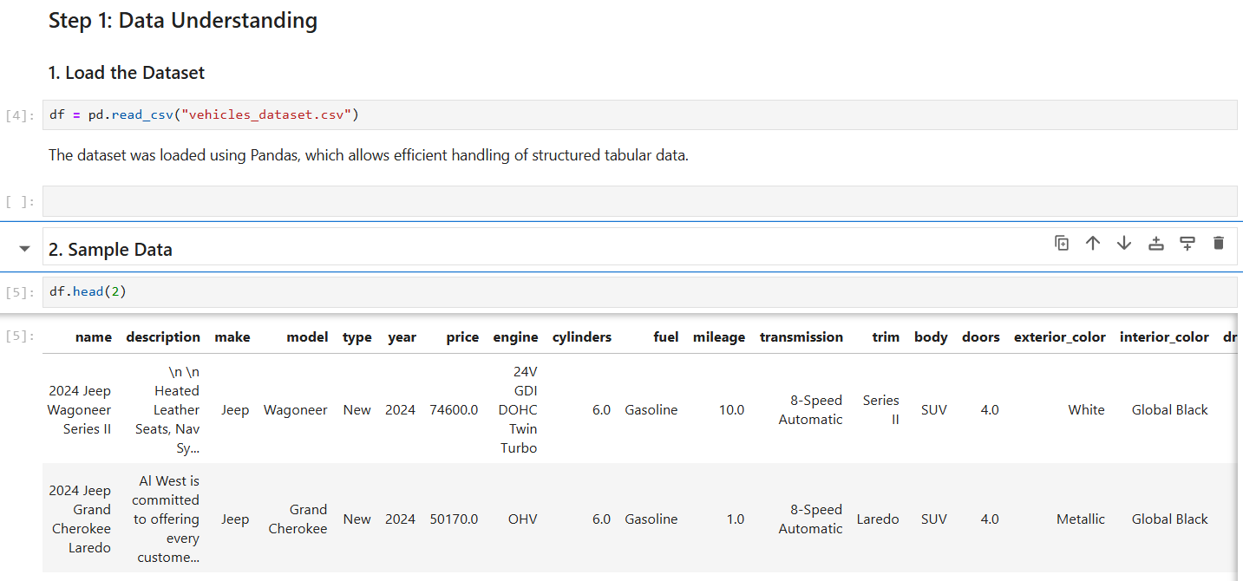
Loading the Dataset

Slide 5
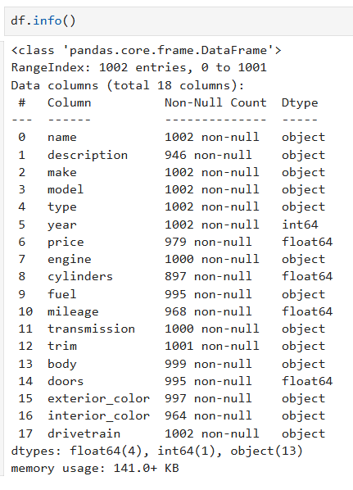
Dataset Structure
The dataset consists of multiple rows and columns, representing individual vehicle records.
It contains a combination of numerical and categorical attributes.
Column data types and non-null counts were inspected using the .info() method.

Slide 6
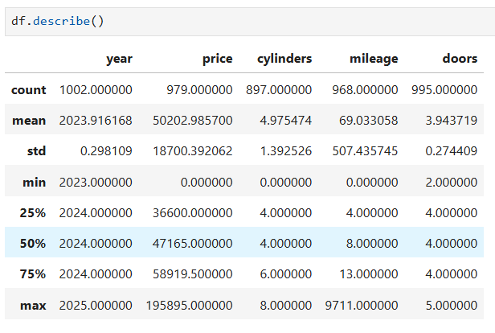
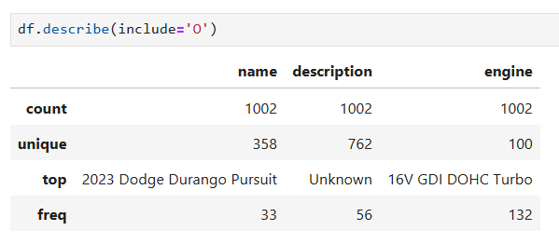
Summary Stats
Summary statistics were generated for all numerical columns using the .describe() method.
Key metrics analyzed included count, mean, minimum, maximum, and standard deviation.

Slide 7
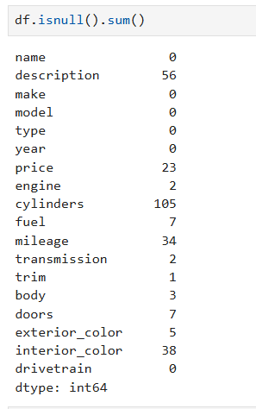
Finding Missing Values
Missing values were identified using the .isnull().sum() method.
Both numerical and categorical columns were found to contain null entries.
Key columns with missing values included price, mileage, cylinders, interior color, and description.

Slide 8
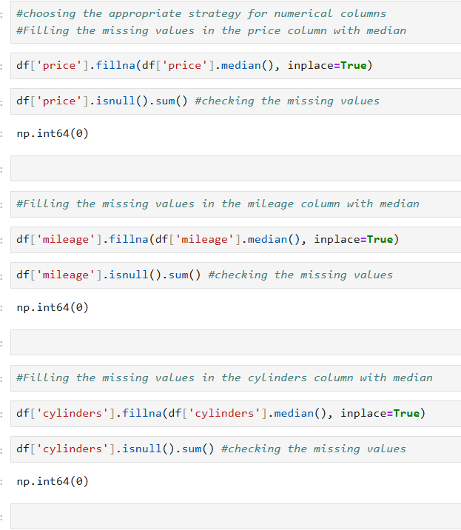
Handling Missing Values
Missing values were identified using null count analysis
Numerical columns (price, mileage, cylinders, doors) Filled using median to handle skewness and outliers
Categorical columns (fuel, transmission, body, colors) Filled using mode or 'Unknown' where appropriate
Strategy chosen based on data type and analytical impact

Slide 9
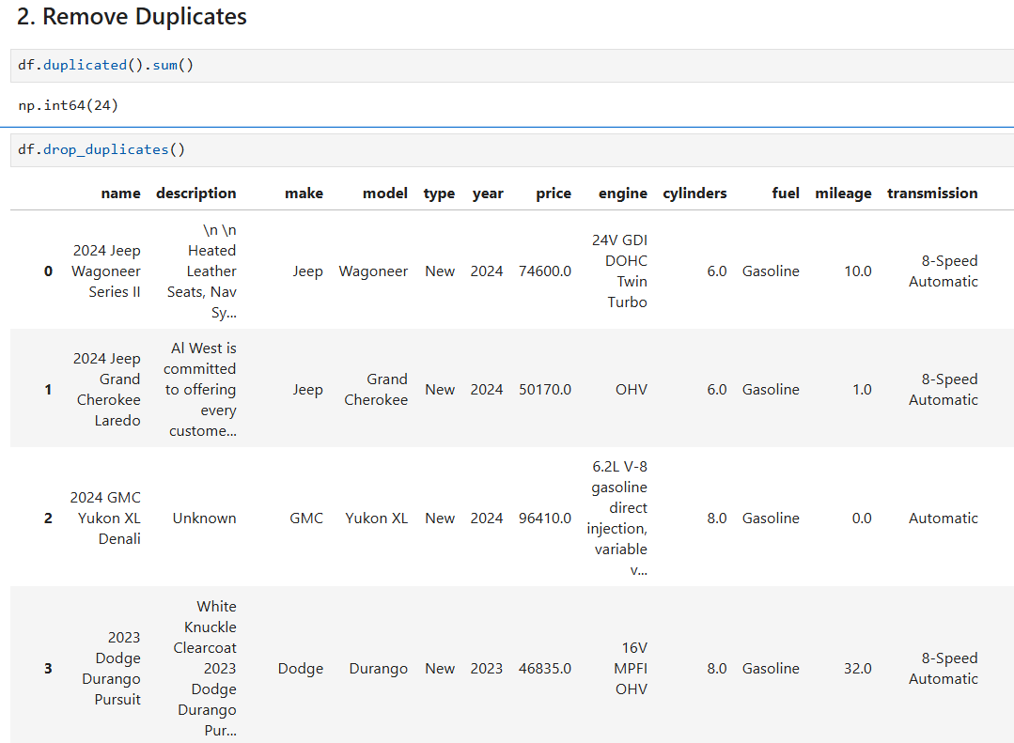
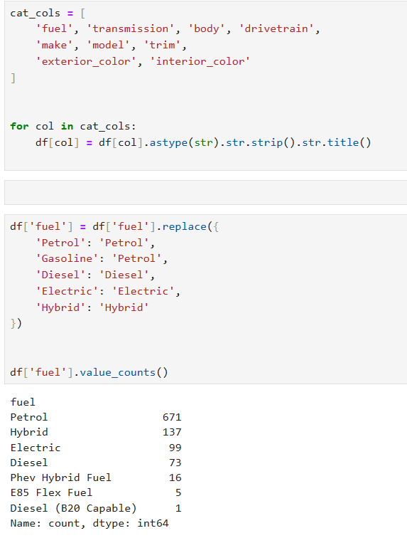
Removing Duplicates & Inconsistencies
Duplicate records were detected using .duplicated().sum()
Exact duplicates were removed to avoid biased results using .drop_duplicates()
Categorical inconsistencies fixed by:
                Standardizing text case
  Removing extra spaces
  Merging equivalent categories (e.g., Petrol vs Gasoline)

Slide 10
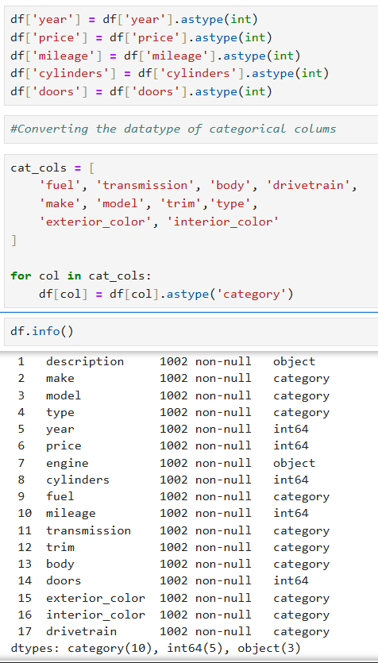
Data Type Corrections
Numerical columns converted to appropriate integer types
Categorical columns converted to category data type
Corrections ensured:
  Accurate calculations
  Efficient grouping operations
  Reduced memory usage

Slide 11
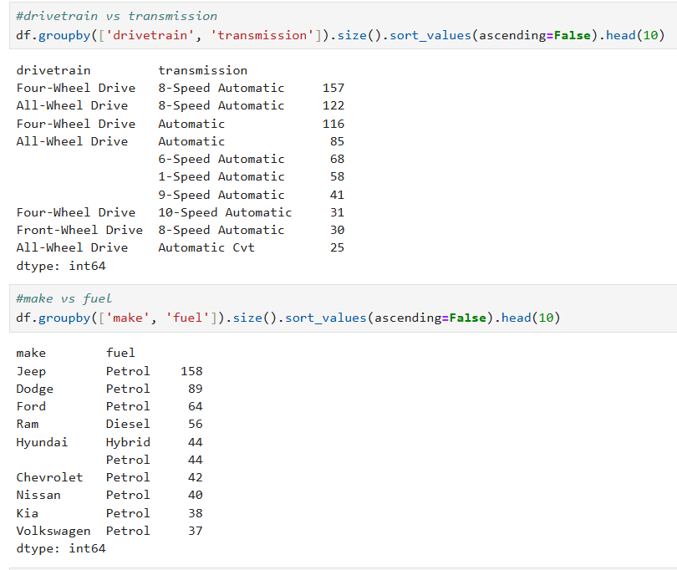
Bivariate Insights
Categorical vs Categorical
  Automatic transmission dominates across most fuel types

Slide 12
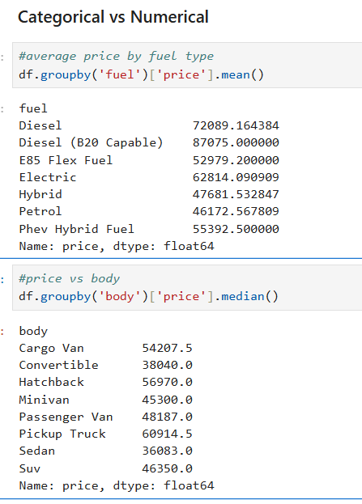
Bivariate Insights
Categorical vs Numerical
  Electric and AWD vehicles show higher median prices
  Vehicle which uses Diesel (B20 Capable) has the higher average price
  Cargo van displays the higher median prices

Slide 13
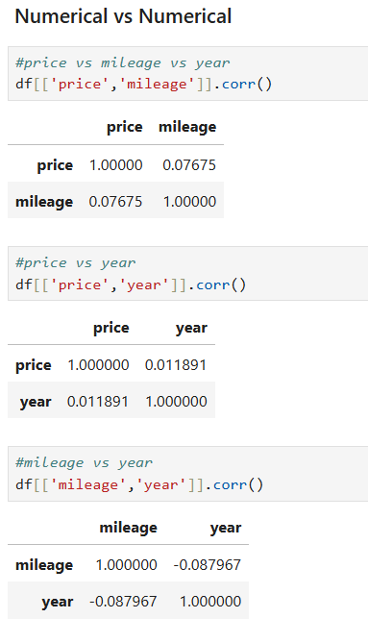
Bivariate Insights
Numerical vs Numerical
  Price decreases as mileage increases
  Newer vehicles tend to have higher prices

Slide 14
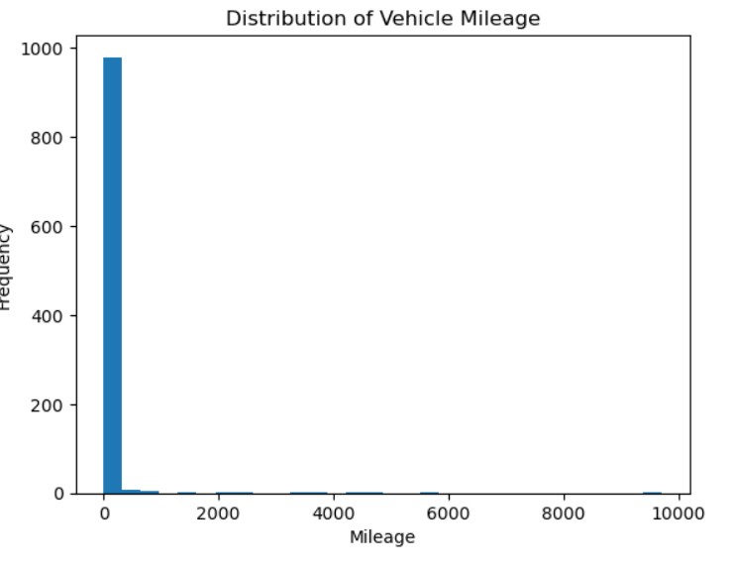
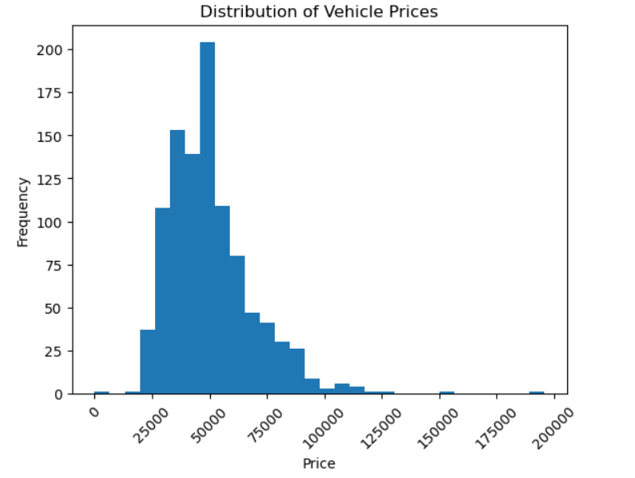
Univariate Visualization:
Understanding price distribution from price
Price is right-skewed
Few high-priced vehicles create outliers
Understanding vehicle usage by mileage
Majority vehicles fall in low mid mileage range
Very high mileage vehicles are fewer

Slide 15
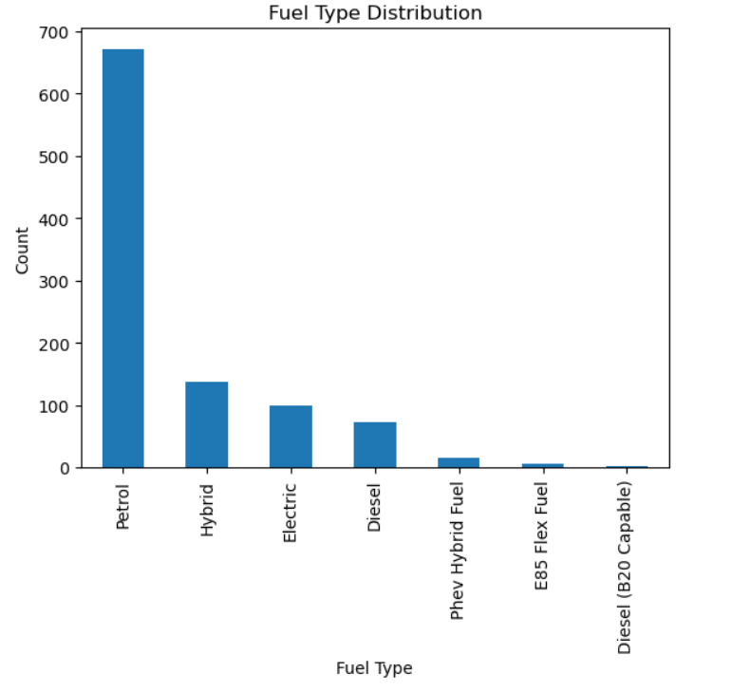
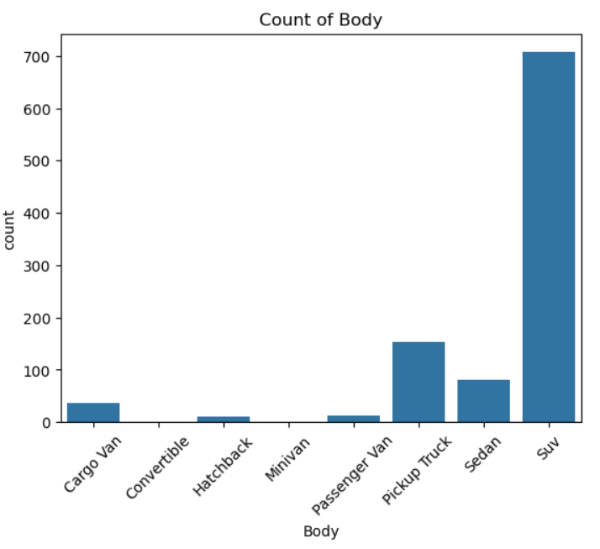
Univariate Visualization:
Understanding vehicle fuel dominance
Petrol and Diesel dominate the dataset
Electric/Hybrid vehicles are underrepresented
SUV clearly has the highest popularity
Convertible and minivan are the least preferable

Slide 16
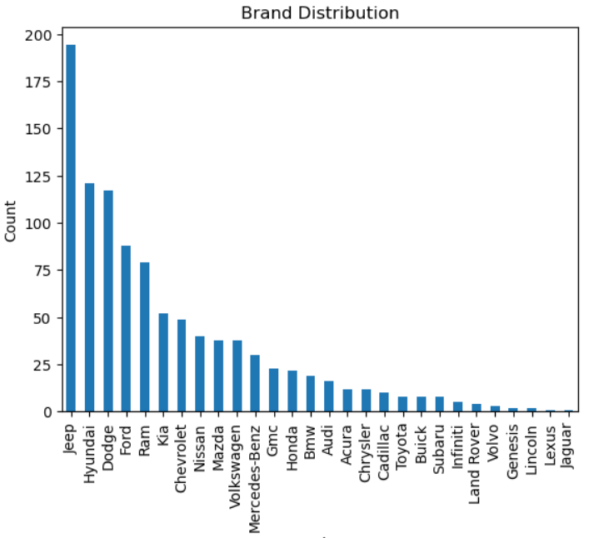
Univariate Visualization:
The dataset is imbalanced across brands.
A small number of brands dominate the dataset.
This imbalance can influence predictive models and requires normalization or weighting.

Slide 17
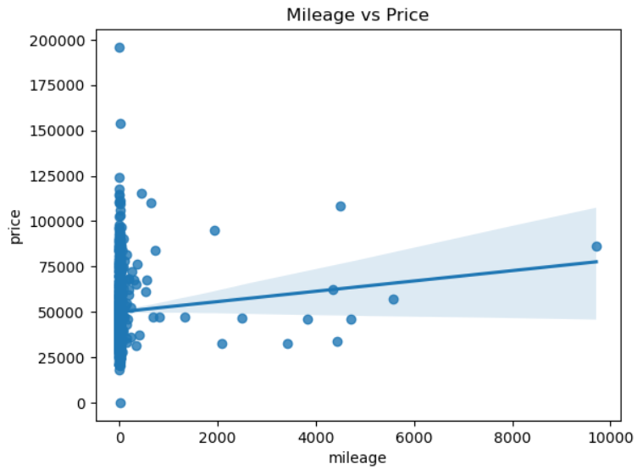
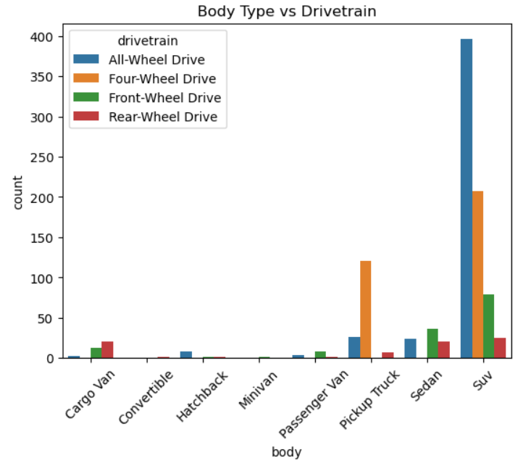
Bivariate Visualization:
Understanding relation of price and mileage
Clear negative relationship
Higher the mileage, lower the price
Understanding relation of body type and drivetrain
From the above distribution the SUV with All-Wheel drive has the highest dominance

Slide 18
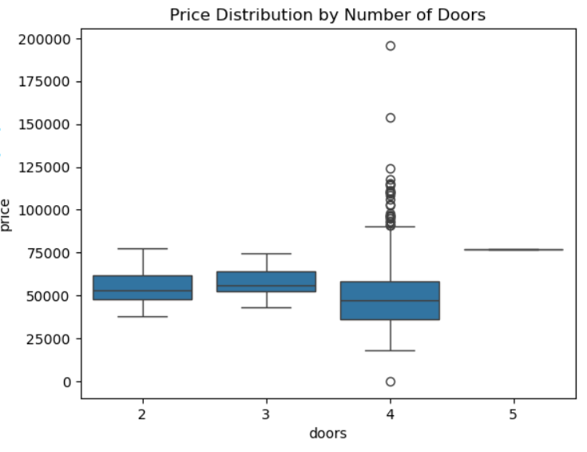
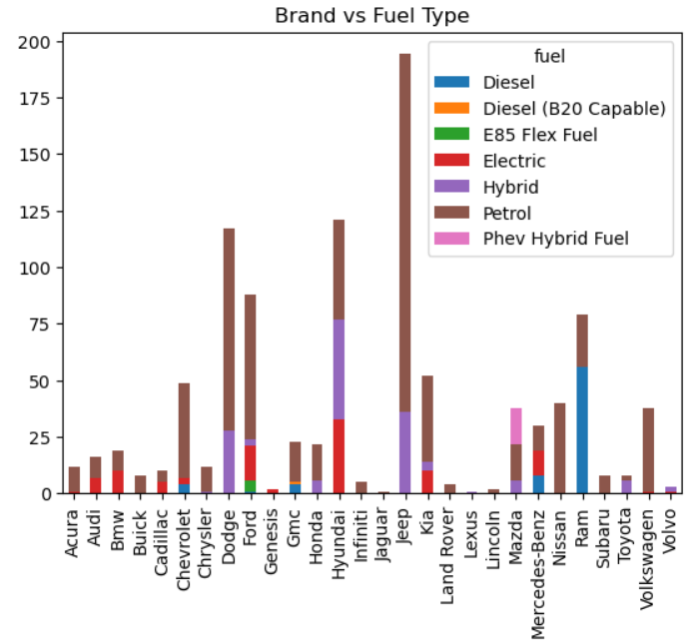
Bivariate Visualization:
2-door vehicles show higher median prices with wider variance.
4-door vehicles cluster around mid-range pricing, indicating mass-market positioning.
Certain brands specialize in specific fuel types.
Market positioning differs clearly across brands.
Indicates segmented product strategies.

Slide 19
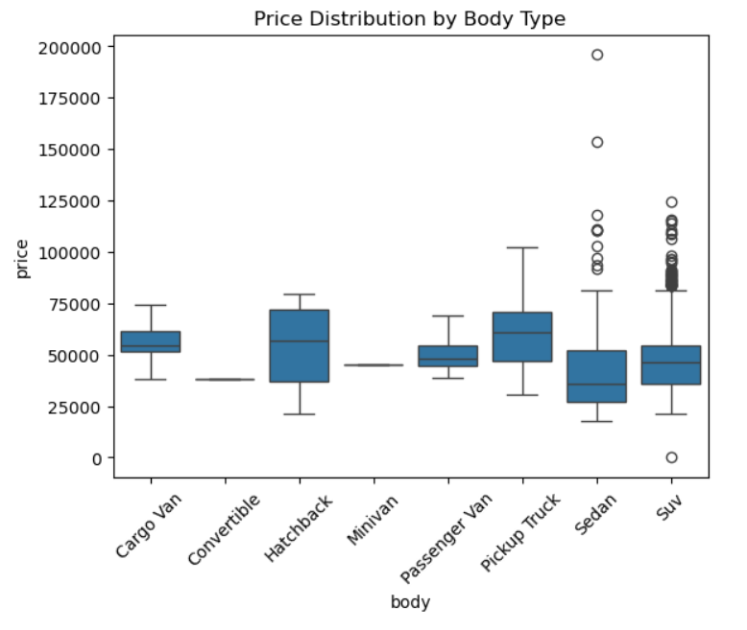
Bivariate Visualization:
Understanding price distribution by body type
Pickup Trucks and SUVs command higher prices
Hatchbacks and Sedans show high price variability
Van and convertible body types have stable pricing

Slide 20
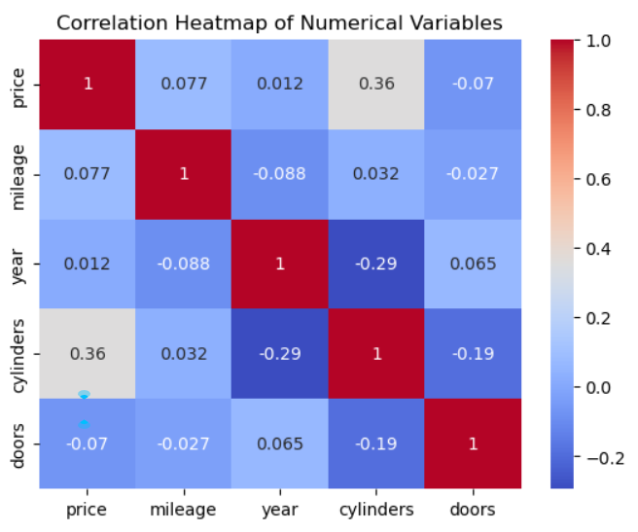
Multivariate Visualization:
Price shows a strong positive correlation with year and a positive correlation with mileage, confirming that newer, less-used vehicles retain higher value.
cylinders has a positive relationship with price shows weak correlation, indicating that engine performance influences pricing more than body configuration.
The strong negative correlation between year and mileage highlights potential multicollinearity, which should be handled carefully in predictive models.

Slide 21
Conclusion
SUVs, pickups, and luxury body types show higher median prices and wider price dispersion.
SUVs and pickups are heavily skewed toward AWD/4WD built for performance, load, and rough terrain.
Pricing is driven by multiple factors, not a single variable. Vehicle characteristics significantly affect pricing.
Sedans and hatchbacks cluster at the lower end with tighter price ranges.

Slide 22

THANK YOU

